Slide 1

SMART LOCK SYSTEM
CS – 225/ CS-226 Switching Theory Project – 2020.
AI powered FSM based lock
Nischal A (1801CS33)
B.Tech 2nd Year,
Computer Science and Engineering
IIT - Patna

Slide 2
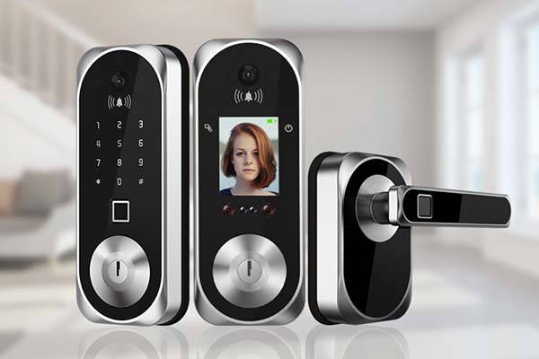
About
A lock system that has two levels of security.
First, Face Recognition to decide whether the person is authorised to open the lock
Second, A pin system, which unlocks only on entering the right pin.

Slide 3
Motivation
Locks are very essential for safeguarding valuables and protection against intruders.
The Smart lock design implemented here uses two step validation method to allow access.
Inspired by Machine Learning – IoT (Internet of Things) based applications.

Slide 4
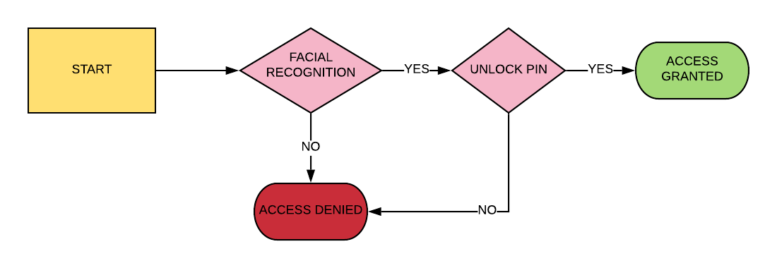
Model Blueprint

Slide 5
IMPLEMENTATION
Software:-
Face Recognition – OpenCV, Keras (Tensorflow)
PIN Checking – FSM (Moore Machine) – in Verilog
Hardware:-
Raspberry Pi
Raspberry Pi Camera
Solenoid Lock
External DC power source
Jumper wires

Slide 6
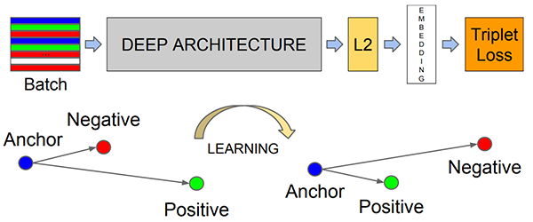
SOFTWARE IMPLEMENTATION
1) FACE RECOGNITION
Training – Done to reduce the Triplet Loss function. This brings the embedding vectors of similar faces close to each other.
Evaluation -
The Neural Network Model generates a 128 – Dimensional embedding for each face. It checks this with the embeddings to find to which it is closest to.

Slide 7
SOFTWARE IMPLEMENTATION - Continued
2) Lock Pin System – A Moore Machine implemented in Verilog.
Description of the FSM:-
Inputs – The inputs to the FSM
Keyin – 0 or 1 value to enter the binary number to open the lock
Enter – To confirm after Keyin press
Reset – Takes back to the initial state
Outputs – The outputs from the FSM
Unlock – 1 for access granted and 0 for access denied
Error – 1 for access denied and 0 for access granted

Slide 8
SOFTWARE IMPLEMENTATION - Continued
Description of the FSM - continued:-
Lock_key – a n-bit binary number representing the key for unlocking
Valid – A single bit number denoting if the face is recognised. 1 – face recognised, 0 – face unrecognised.

Slide 9
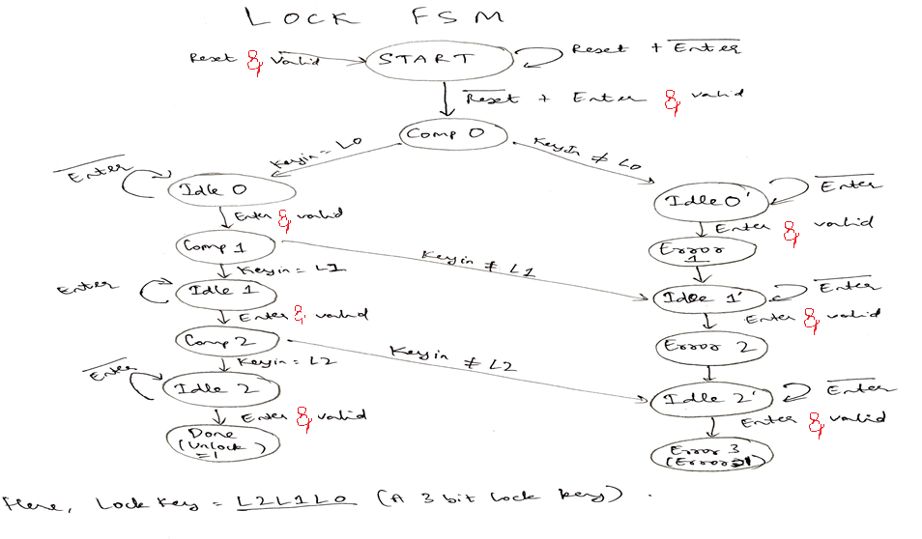
FSM – State Diagram

Slide 10
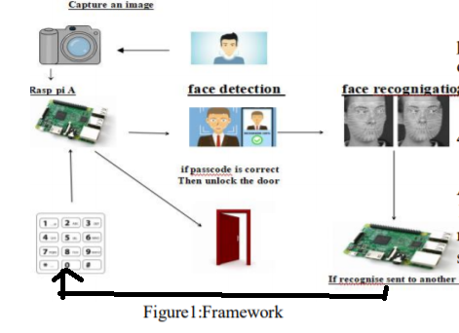
FRAMEWORK
STEPS of functioning:-
Camera captures the image
Image is authorised with the database
If image is present in database then “valid” = 1 else “valid”=0
If valid = 1 then lock keypad appears – User enters the pin and presses enter.
If pin is right then access is granted.

Slide 11
HARDWARE IMPLEMENTATION
Raspberry Pi (RP) – An ARM based single board computer. It uses a open-source OS Raspbian.
Pi CAMERA – This is a custom designed add on for RP. It makes use of CSI bus that carries data at high rates.
Keypad – With the inputs as required by our FSM (keyin, enter, reset).
Servo – Attached to the GPIO of the RP (powered by a 6V battery).

Slide 12
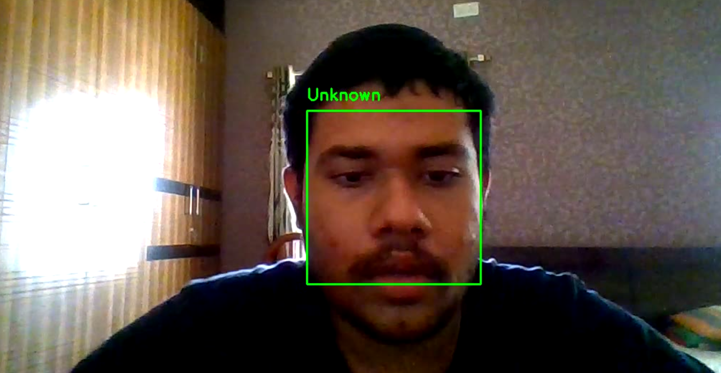
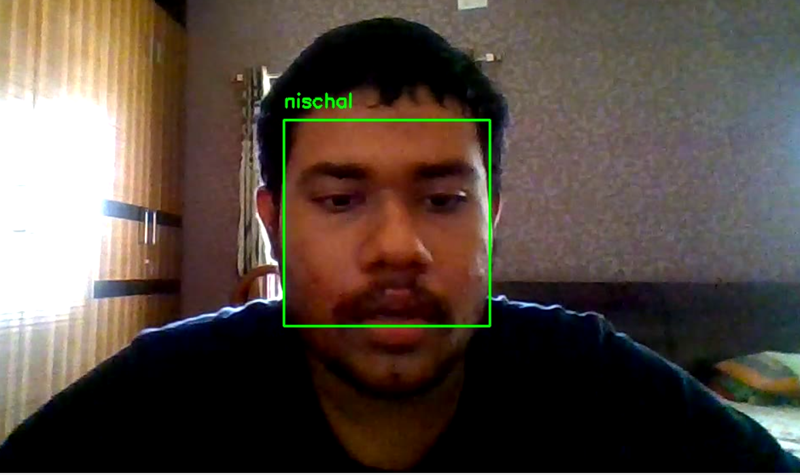
Results
1) Face recognition model
Before Training – Unknown Person – Access Denied
After Training – Person recognised – Access Granted for entering lock pin.

Slide 13
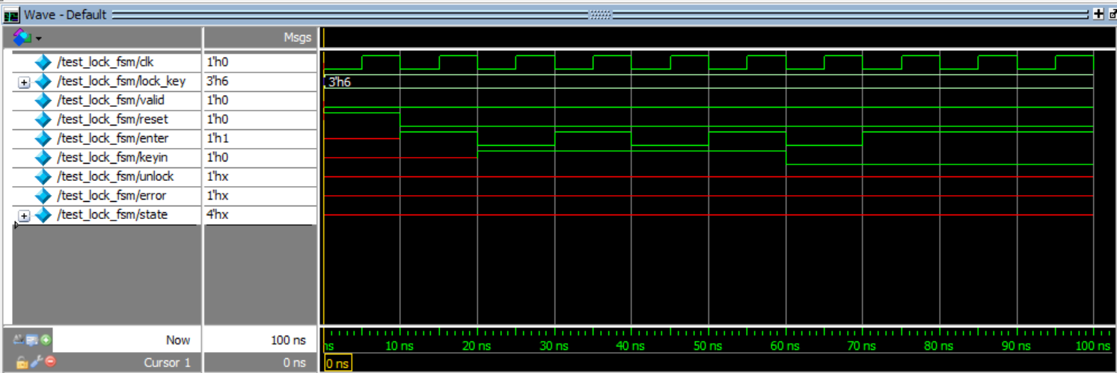
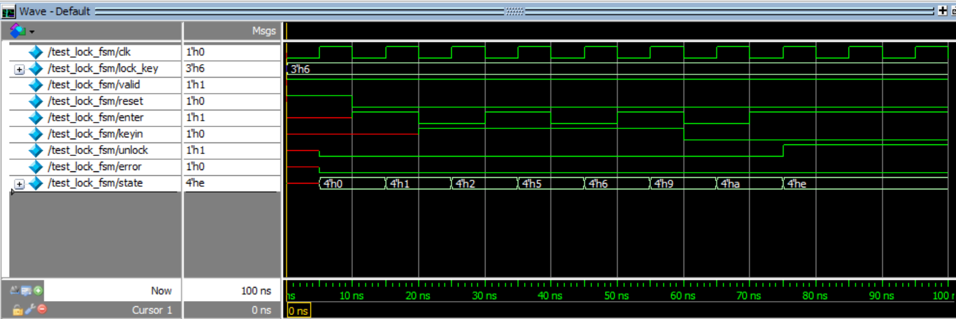
Results - Continued
Wave form when valid = 0 (face not recognised) Unlock = Don’t care (Not allowed to enter pin)

Slide 14
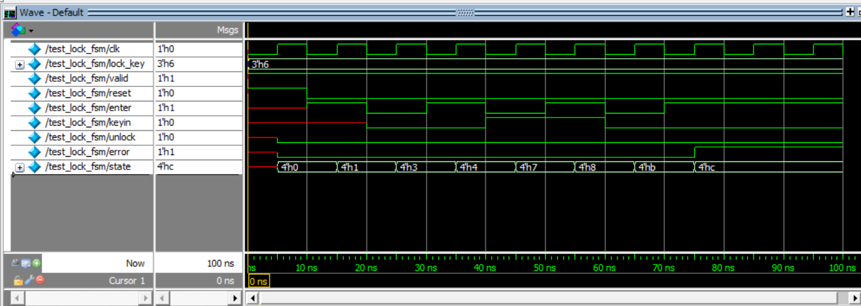
Results - Continued
Wave form when valid = 1 (face recognised) and wrong pin entered - Unlock = 0 ; Error = 1 – Access Denied.

Slide 15
Results - Continued
Wave form when valid = 1 (face recognised) and correct pin entered – Unlock = 1 means Access Granted

Slide 16
APPLICATIONS
For highly confidential safes/ wardrobes.
In Door lock system for opening the doors of certain rooms/ main house door.

Slide 17
ADVANTAGES
2 level security (face recognition, pin entering) – For extremely confidential purposes.
Easily implementable
Doesn’t require a bulky hardware. Easy to fit on doors and safes.

Slide 18
REFERENCES
Face detection
Overall Architecture
FSM based lock

